Slide 1
Convolutional Neural Network
Feng Jiangtao
12302010026

Slide 2
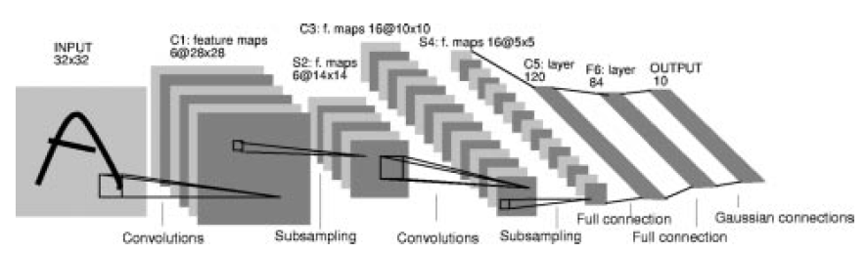
LeNet-5

Slide 3
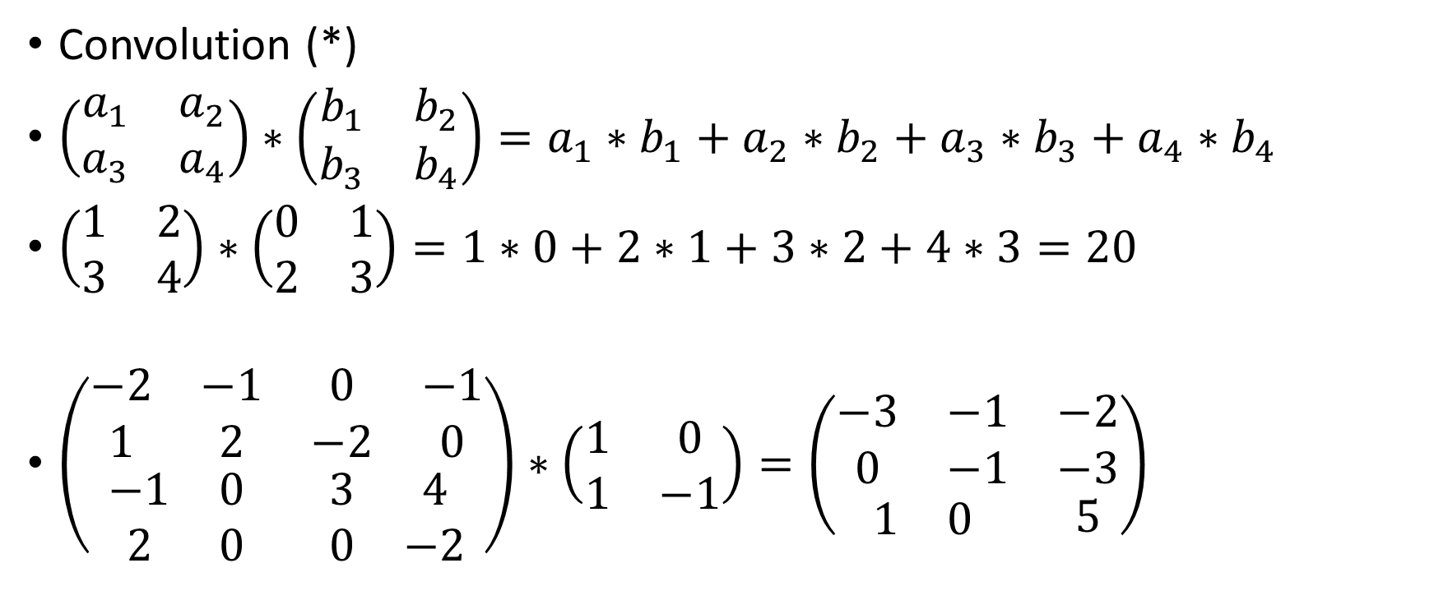
Convolution Layer
Convolution (*)
$\left(\begin{matrix}a_{1} & a_{2} \\ a_{3} & a_{4}\end{matrix}\right)∗\left(\begin{matrix}b_{1} & b_{2} \\ b_{3} & b_{4}\end{matrix}\right)=a_{1}∗b_{1}+a_{2}∗b_{2}+a_{3}∗b_{3}+a_{4}∗b_{4}$
$\left(\begin{matrix}1 & 2 \\ 3 & 4\end{matrix}\right)∗\left(\begin{matrix}0 & 1 \\ 2 & 3\end{matrix}\right)=1∗0+2∗1+3∗2+4∗3=20$
$\left(\begin{matrix}\begin{matrix}−2 & −1 \\ 1 & 2\end{matrix} & \begin{matrix}0 & −1 \\ −2 & 0\end{matrix} \\ \begin{matrix}−1 & 0 \\ 2 & 0\end{matrix} & \begin{matrix}3 & 4 \\ 0 & −2\end{matrix}\end{matrix}\right)∗\left(\begin{matrix}1 & 0 \\ 1 & −1\end{matrix}\right)=\left(\begin{matrix}\begin{matrix}−3 & −1 \\ 0 & −1\end{matrix} & \begin{matrix}−2 \\ −3\end{matrix} \\ \begin{matrix}1 & 0\end{matrix} & 5\end{matrix}\right)$

Slide 4
Convolution Layer
Hyper Parameters:
Feature Map Number, Kernel Number, Kernel Size, Stride
Learning Rate, Regularization Rate

Slide 5
Convolution Layer
Forward (narrow convolution)
For each kernel,
Input: matrix
Output: matrix
Operation: Convolution
For each feature map,
Sum up all the related kernels

Slide 6
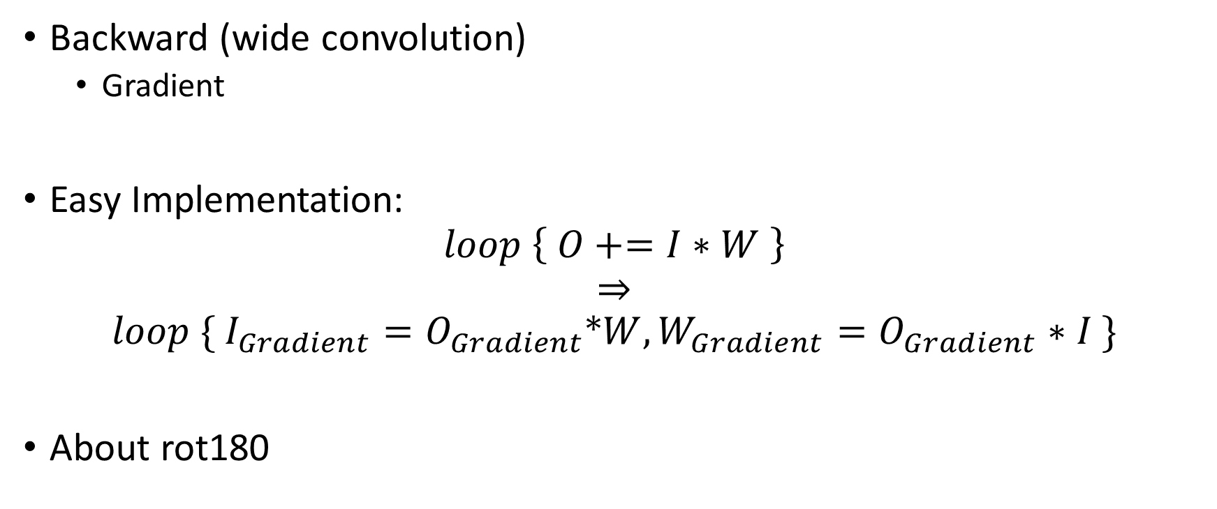
Convolution Layer
Backward (wide convolution)
Gradient
Easy Implementation:
$$loop \left\{ O+=I∗W \right\}$$
$$⇒$$
$$loop \{ I_{Gradient}=O_{Gradient}∗W, W_{Gradient}=O_{Gradient}∗I \}$$
About rot180

Slide 7
Subsampling Layer
Function: Reduce the size of input matrix
Hyper Parameters:
Kernel Size, Stride
(weight)
Usually,
Max Pooling
Mean Pooling

Slide 8
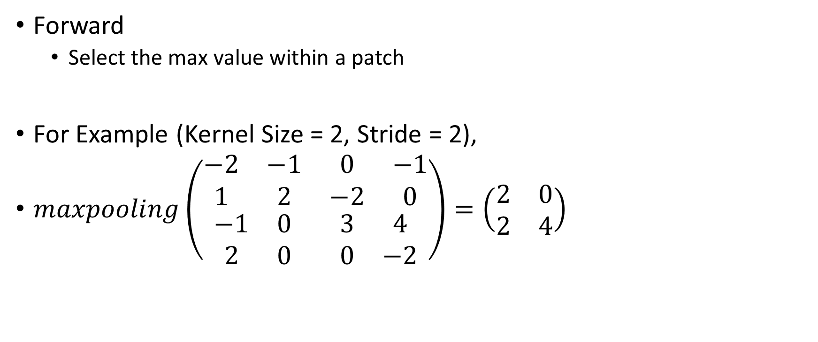
Max Pooling
Forward
Select the max value within a patch
For Example (Kernel Size = 2, Stride = 2),
$maxpooling\left(\begin{matrix}\begin{matrix}−2 & −1 \\ 1 & 2\end{matrix} & \begin{matrix}0 & −1 \\ −2 & 0\end{matrix} \\ \begin{matrix}−1 & 0 \\ 2 & 0\end{matrix} & \begin{matrix}3 & 4 \\ 0 & −2\end{matrix}\end{matrix}\right)=\left(\begin{matrix}2 & 0 \\ 2 & 4\end{matrix}\right)$

Slide 9

Max Pooling
Backward
$maxpooling\left(\begin{matrix}\begin{matrix}−2 & −1 \\ 1 & 2\end{matrix} & \begin{matrix}0 & −1 \\ −2 & 0\end{matrix} \\ \begin{matrix}−1 & 0 \\ 2 & 0\end{matrix} & \begin{matrix}3 & 4 \\ 0 & −2\end{matrix}\end{matrix}\right)=\left(\begin{matrix}2 & 0 \\ 2 & 4\end{matrix}\right)$
$gradient\left(\begin{matrix}−1 & 0 \\ −1 & 1\end{matrix}\right)=\left(\begin{matrix}\begin{matrix}0 & 0 \\ 0 & −1\end{matrix} & \begin{matrix}0 & 0 \\ 0 & 0\end{matrix} \\ \begin{matrix}0 & 0 \\ −1 & 0\end{matrix} & \begin{matrix}0 & 1 \\ 0 & 0\end{matrix}\end{matrix}\right)$

Slide 10
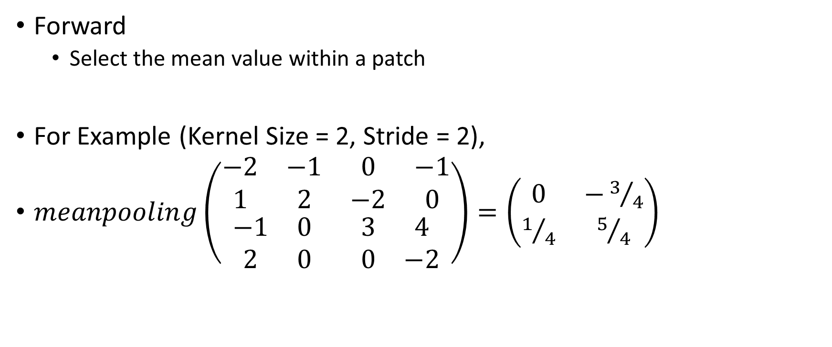
Mean Pooling
Forward
Select the mean value within a patch
For Example (Kernel Size = 2, Stride = 2),
$meanpooling\left(\begin{matrix}\begin{matrix}−2 & −1 \\ 1 & 2\end{matrix} & \begin{matrix}0 & −1 \\ −2 & 0\end{matrix} \\ \begin{matrix}−1 & 0 \\ 2 & 0\end{matrix} & \begin{matrix}3 & 4 \\ 0 & −2\end{matrix}\end{matrix}\right)=\left(\begin{matrix}0 & −3/4 \\ 1/4 & 5/4\end{matrix}\right)$

Slide 11
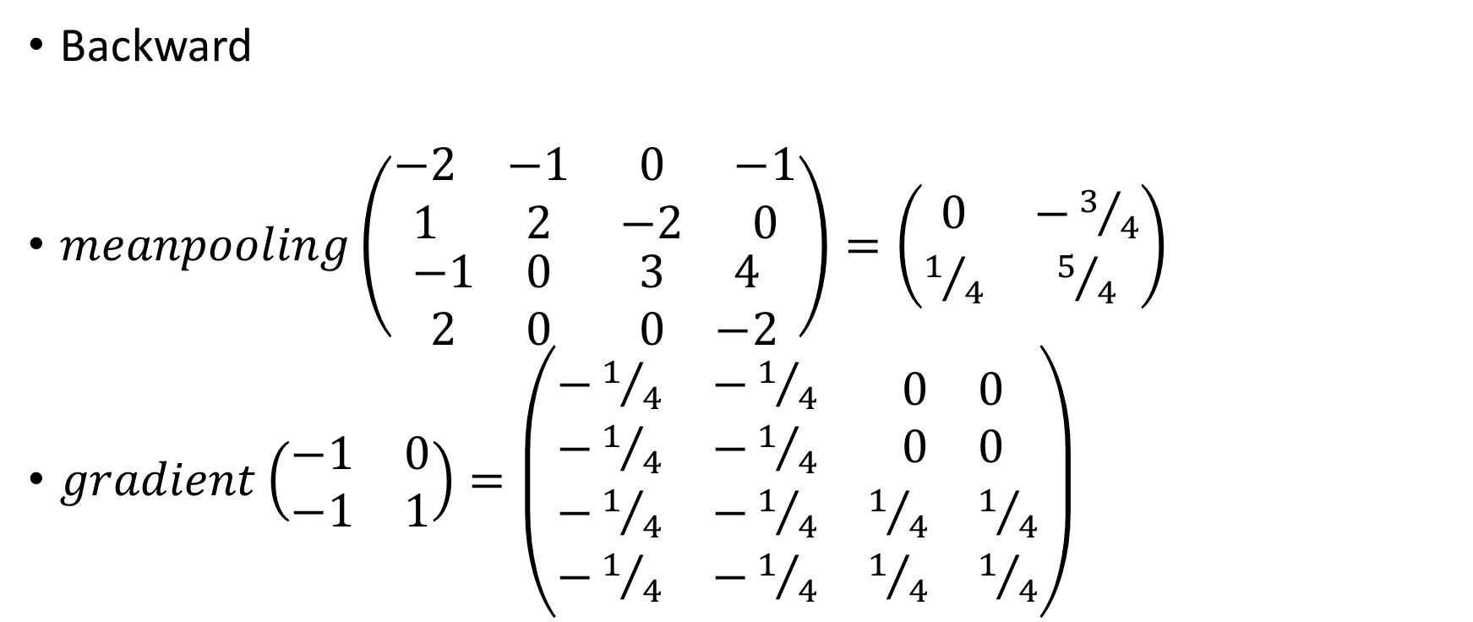
Mean Pooling
Backward
$meanpooling\left(\begin{matrix}\begin{matrix}−2 & −1 \\ 1 & 2\end{matrix} & \begin{matrix}0 & −1 \\ −2 & 0\end{matrix} \\ \begin{matrix}−1 & 0 \\ 2 & 0\end{matrix} & \begin{matrix}3 & 4 \\ 0 & −2\end{matrix}\end{matrix}\right)=\left(\begin{matrix}0 & −3/4 \\ 1/4 & 5/4\end{matrix}\right)$
$gradient\left(\begin{matrix}−1 & 0 \\ −1 & 1\end{matrix}\right)=\left(\begin{matrix}\begin{matrix}−1/4 & −1/4 \\ −1/4 & −1/4\end{matrix} & \begin{matrix}0 & 0 \\ 0 & 0\end{matrix} \\ \begin{matrix}−1/4 & −1/4 \\ −1/4 & −1/4\end{matrix} & \begin{matrix}1/4 & 1/4 \\ 1/4 & 1/4\end{matrix}\end{matrix}\right)$

Slide 12

ReLU
$ReLU\left(x\right)=\left\{\begin{aligned}x, if x>0 \\ 0, otherwise\end{aligned}\right.$

Slide 13
Convolutional Neural Network

Slide 14
Thank you!

